Slide 1


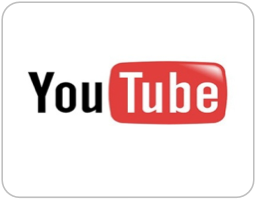

Measuring User Influence in Twitter:
The Million Follower Fallacy
Meeyoung Cha
Max Planck Institute for Software Systems (MPI-SWS)
Korea Advanced Institute of Science and Technology (KAIST)
With Hamed Haddadi (U. of London) Fabricio Benevenuto (UFMG)
and Krishna Gummadi (MPI-SWS)
KSIDI June 9, 2010

Slide 2
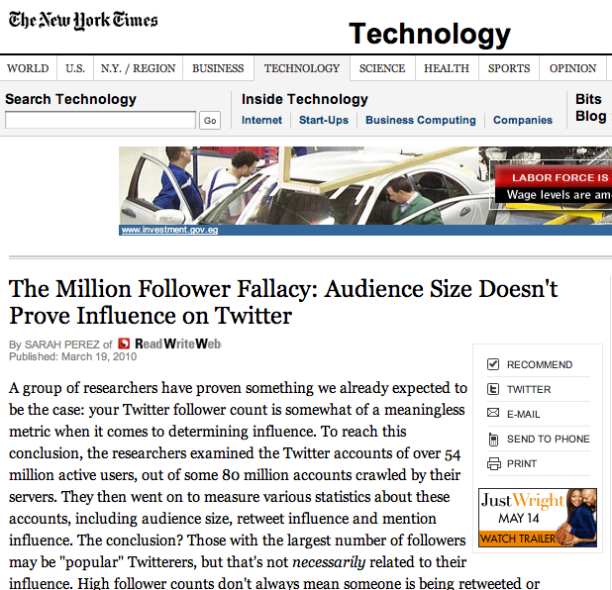
How can we measure user influence?

Slide 3
Motivation
Social media has become extremely popular
Billions of dollars spent in marketing in social media
  Political campaigning, content sharing, product advertising
Advertisers want to find influential users
Lack of understanding about the actual influence patterns
  Many are simply interested in increasing the audience size
  Plethora of tips on how to increase follower count
How can we measure influence of a user?

Slide 4
Our goal
Characterize influence in social media and study its dynamics
(Influence: potential to cause others to engage in a certain act)
  1. How can we measure influence of a single user?
  2. Does influence of a user hold across topics?
  3. What behaviors make ordinary users influential?
Considered Twitter as a medium of influence for our study

Slide 5


Data
Methodology
Measuring
Influence
Topical
Dynamics

Slide 6

Why ?
One of the most popular social media
  Created in 2006, top-11 visited site by Alexa.com in 2010
Social links are the primary way how information flows
  Users can follow any public messages, called tweets, they like
Traditional media sources and word-of-mouth coexist
  Mainstream media sources (BBC, CNN, DowningSteet)
  Celebrities (Oprah Winfrey), politicians (Barack Obama)
  Ordinary users (like you and me!)

Slide 7
Measurement
Crawled near-complete Twitter data from 2006 to Sep 2009
  Asked Twitter to white-list 58 machines
  Crawled information about user profiles and all tweets ever posted
  starting from user ID of 0 to 80 million
Gathered 54M users, 2B follow links, and 1.7B tweets
  8.5% of users set their profiles private (hence their tweets not available)
  User profile includes join date, name, location, time zone information
  Exact time stamp of tweets available

Slide 8
High-level data characteristics
95% of users belong to the largest connected component (LCC)
Low reciprocity (10%)
Power-law node degree distribution with extremely large hubs
  99% of users have fewer than 200 followers
  500 users have more than 100,000 followers
Low tweeting activity in general
  Only 6,189,636 or 11% of all users posted at least 10 tweets
Studied how 6M active users interact with the entire 54M users

Slide 9
Data
Methodology
Measuring
Influence
Topical
Dynamics

Slide 10
Three measures of influence
Indegree
  How many people get to hear you, measured by the
  number of followers
Mentions
  How many people have read carefully what you said and have bothered to respond to you
Retweets
  How many people have read what you said and have bothered to forward the message further

Slide 11


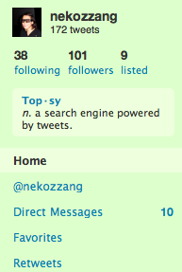

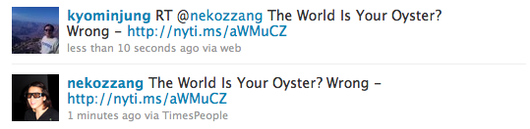

Examples
Various conventions help interaction among users
  RT means to “re-tweet” or forward a tweet
  @ reference refers to a user’s screen name
mention
retweet

Slide 12
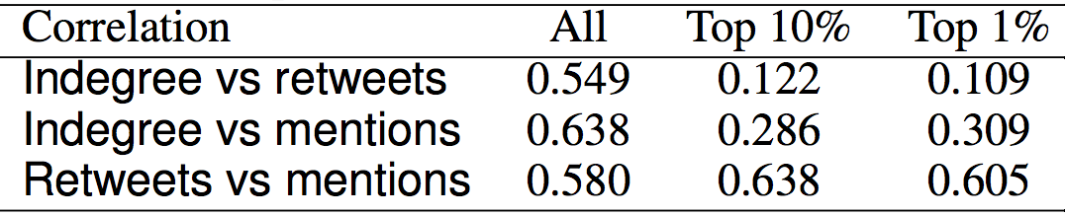
Are the three measures related?
Compared the relative ranks of a user across three measures using Spearman’s rank correlations
  A perfect positive (negative) correlation appear as 1 (-1)
  Ties receive the same averaged ranks
Indegree generally correlates with retweets and mentions.
For the top users, indegree alone cannot predict the others.

Slide 13
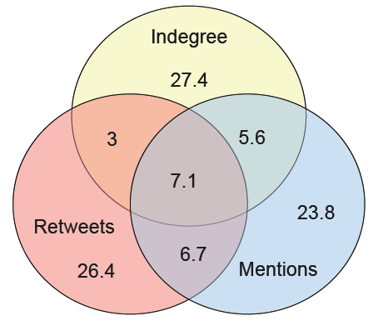
Overlap in top users across measures
Venn diagram of the top 100 users across the three measures:
The chart is normalized so that the total is 100%.
A mix of news outlets
and public figures
The three measures capture different types of influence
Trackers for
trending topics
Celebrities

Slide 14
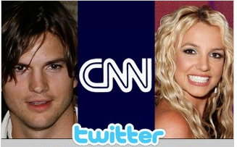
Example from the top 100 users
Indegree
rank 1
3.3M
rank 4
2.6M
rank 2
3.1M
Mentions
rank 6
-
rank 71
Retweets
rank 7
rank 24
-
The million follower fallacy!

Slide 15
Data
Methodology
Measuring
Influence
Topical
Dynamics

Slide 16
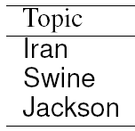
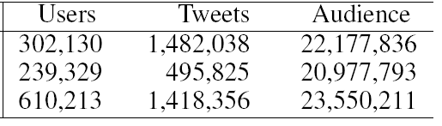

Finding users engaging in multiple topics
Picked three popular topics in 2009
  Used keywords to identify relevant tweets for a 2 month period
  Ex) Iran: #iranelection, names of politicians
  Only 13,219 users talked
  about all three topics
Study to what extent influence of 13K users vary across topics

Slide 17
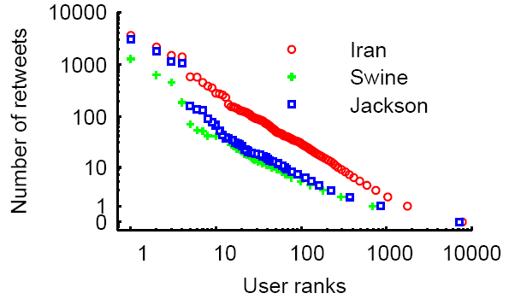

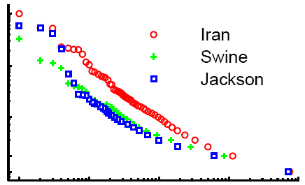
User ranks for a given topic
Distribution of user ranks based on the retweets measure
(the number of retweets a user spawned on the topic)
Mentions show
a similar pattern
Power-law in the retweets and mentions popularity
➔ Utilizing top users in ads has a great potential payoff

Slide 18
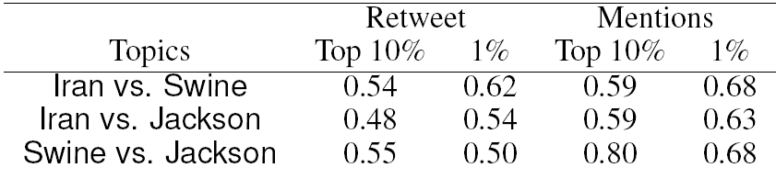


Does a user’s influence hold over topics?
Compared the relative ranks of a user across three topics using Spearman’s rank correlations
Correlation generally high
Gets stronger for top 1%
Mentions show a
stronger correlation

Slide 19

Summary
Twitter as a medium of influence
Compared three measures of influence (indegree, retweets, and mentions) and examined its dynamics
Also in the paper: how influence of a user varies over time
Implication: Indegree alone reveals little about influence; Marketers may want to focus more on audience engagement
Future work: influence patterns for less popular topics
http://twitter.mpi-sws.org

Slide 20
Other work on OSN research

Slide 21

Other work
  Information propagation through social links
    Coined a term “social cascade”
    How quickly and widely does information spread? [WWW’09, ICWSM DC’09]
    Is social cascade similar to the spread of diseases? [ACM WOSN’08]
    How do we measure a single user’s influence? [ICWSM’10]
  Activity and workloads
    How do pairs of users interact over a long time period? [ACM WOSN’09]
    What activities do users engage in on social networks? [ACM IMC’09]

Slide 22

Future research
Information flow
Data-driven social science
Facilitate quick and wide information propagation
(modeling the spreading, identifying inhibitors,
designing web features, testing new systems)
Proactive and scalable service design
(predict user activity, pre-fetch content, advertisements)
2008 2009 2010 2011 2012 2013

Slide 23
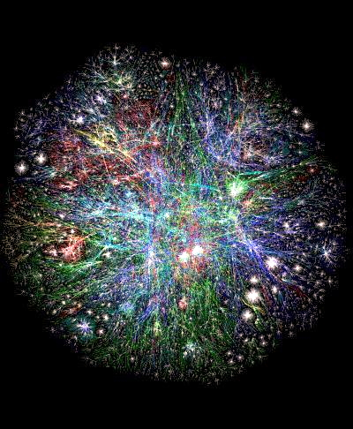
Meeyoung Cha
Social network research
http://socialnetworks.mpi-sws.org
http://twitter.mpi-sws.org
YouTube research
http://an.kaist.ac.kr/traces/IMC2007.html
IPTV research
http://research.tid.es/internet/

Slide 24
Discussion: Twitter vs. other OSNs

